Slide 1

Project Report on Micro Credit Loan Defaulters
By:
Ajit K Mohanty

Slide 2
Background & Introduction
A Microfinance Institution (MFI) is an organization that offers financial services to low income populations. Microfinance services (MFS) becomes very useful when targeting especially the unbanked poor families living in remote areas with not much sources of income. The MFS provided by MFI are Group Loans, Agricultural Loans, and Individual Business Loans and so on.
Now a days telecom industries launched various products and have developed its business and organization based on the budget operator model, offering better products at Lower Prices to all value conscious customers through a strategy of disruptive innovation that focuses on the subscriber.
They understand the importance of communication and how it affects a person’s life, thus focusing on providing their services and products to low income families and poor customers that can help them in the need of hour. They are collaborating with an MFI to provide micro-credit on mobile balances to be paid back in some days e.g. in 5/10/15 days.

Slide 3
Business Problem
MFI to provide micro-credit on mobile balances to be paid back in 5 days. The Consumer is believed to be defaulter if he deviates from the path of paying back the loaned amount within the time duration of 5 days.
For the loan amount of 5 (in Indonesian Rupiah), payback amount should be 6 (in Indonesian Rupiah), while, for the loan amount of 10 (in Indonesian Rupiah), the payback amount should be 12 (in Indonesian Rupiah).
The sample data is provided to us from our client database. It is hereby given to you for this exercise. In order to improve the selection of customers for the credit, the client wants some predictions that could help them in further investment and improvement in selection of customers.
So here we will build a model using classification technique which can be used to predict in terms of a probability for each loan transaction, whether the customer will be paying back the loaned amount within 5 days of issuance of loan. In this case, Label ‘1’ indicates that the loan has been payed i.e. Non- defaulter, while, Label ‘0’ indicates that the loan has not been payed i.e. defaulter.

Slide 4
Approach to Data Cleaning
Here in the data set, there are no missing values are present, so we will directly looking the data’s for different attributes/fields, where we saw there are some data which is not be realistic and those fields are.
Dropped the first attribute which is not required for our analysis.
Checked is there any duplicate data’s present in the dataset or not, if yes we will delete them from data set.
We saw there is a letter 'I' present in the ‘msisdn’ filed, which is mobile number of user, so we removed that for our model building.
amnt_loans90 – records are there where customers did not taken any loan within last 90 days.
aon - some observations having negative data for this field which is age on cellular network in days, but practically it cannot be negative.
pdate - converted the field to Date format and then we converted it to day of the year, which will essay for our model building.
pcircle - we saw that all the values are belongs to one telecom circle, so we dropped this column.

Slide 5
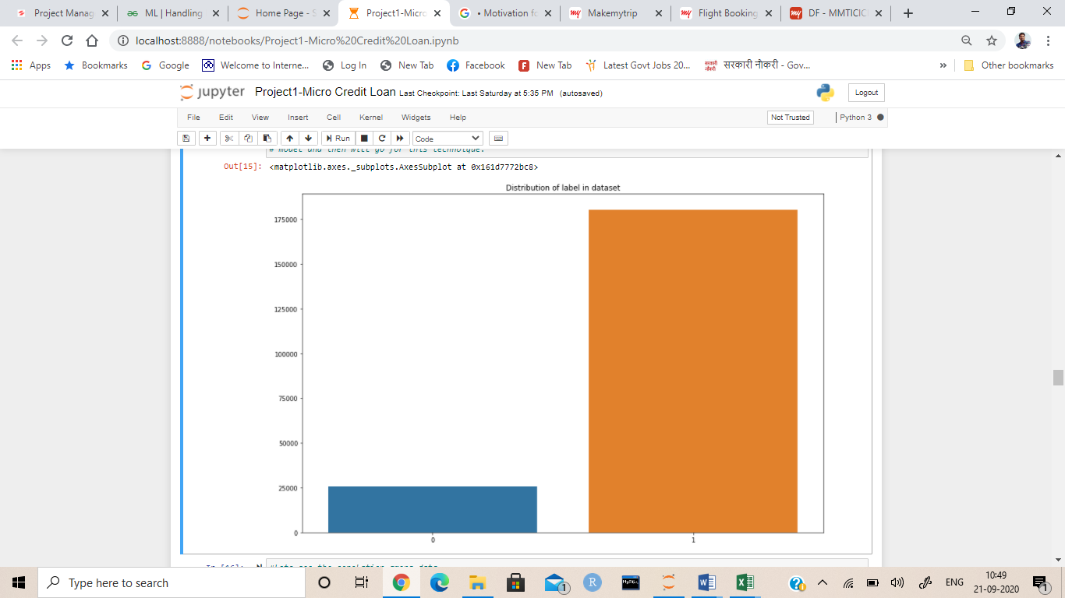
Approach to Data Cleaning (Cntd…)
Also the dataset is imbalanced i.e. Label ‘1’ has approximately 87.5% records, while label ‘0’ has approximately 12.5% records. So we will treat the data’s using over sampling and under sampling technique.

Slide 6
Building Models and Results.
Here we implemented different algorithms which and we finalized DecisionTree Classifier model is the best.
Model | Accuracy_Score | Cross_Value_Score | f1-score | Precision
Logistic Regression | 87.55 | 87.66 | 0.04 | 0.64
KNeighbors Classifier | 88.03 | 88.07 | 0.43 | 0.54
DecisionTree Classifier | 88.20 | 88.37 | 0.54 | 0.53

Slide 7
Refining the Best Model
Here DecisionTree Classifier is the best model, so lets find out the best parameter for this to get maximum score and for that we use grid search method to find optimal values.
So the best parameters are 'criterion': 'entropy' and 'max_depth': 10.
Final results after putting best parameters on DecisionTree Classifier model is given below.
Model | Accuracy_Score | Cross_Value_Score | f1-score | Precision
DecisionTree Classifier | 92 | 92 | 0.62 | 0.74

Slide 8
Conclusion
So here 'DecisionTreeClassifier Model' is the best model out of all model tested above and by looking this we can conclude that our model is predicting around 92% of correct results for Label ‘0’ indicates that the loan has not been payed i.e. defaulter.

